Slide 1
The LionWeb Initiative
at MODELS 2023 MTT
Niko Stotz

Slide 2
Mission and Activities
To create an ecosystem of interoperable components for building language-oriented modeling tools on the web.
Primary: define protocols
meta-metamodel
reference architecture
Secondary: programming language APIs
reference implementations
Also: collaboration hub for components

Slide 3
Principles
Don’t re-invent the wheel for each LWB
Focus on strengths, reuse other parts
LionWeb as boring, reliable base
Innovate on top
Rough consensus and running code
Adopt IEEE approach
Business-friendly Open Source
Apache 2.0 license
Everything is a model
Markus Voelter’s Whitepaper “A Platform for Systems and Business Modeling”

Slide 4
Reference Architecture: Parts
B
C
A
G
1
D
2
F
E
Repository
Model
Original
Derived
Client
Editor
Processor
Model checker
Importer
Generator
A
B
F
G
C
D
E

Slide 5
Reference Architecture: Protocols
1
5
2
4
3
Bulk
Load model, modify, store it back
Load, derive something else
Delta
Initialise with model, get notified of changes, write back changes continuously
2
5
1
4
3

Slide 6
Appendix

Slide 7
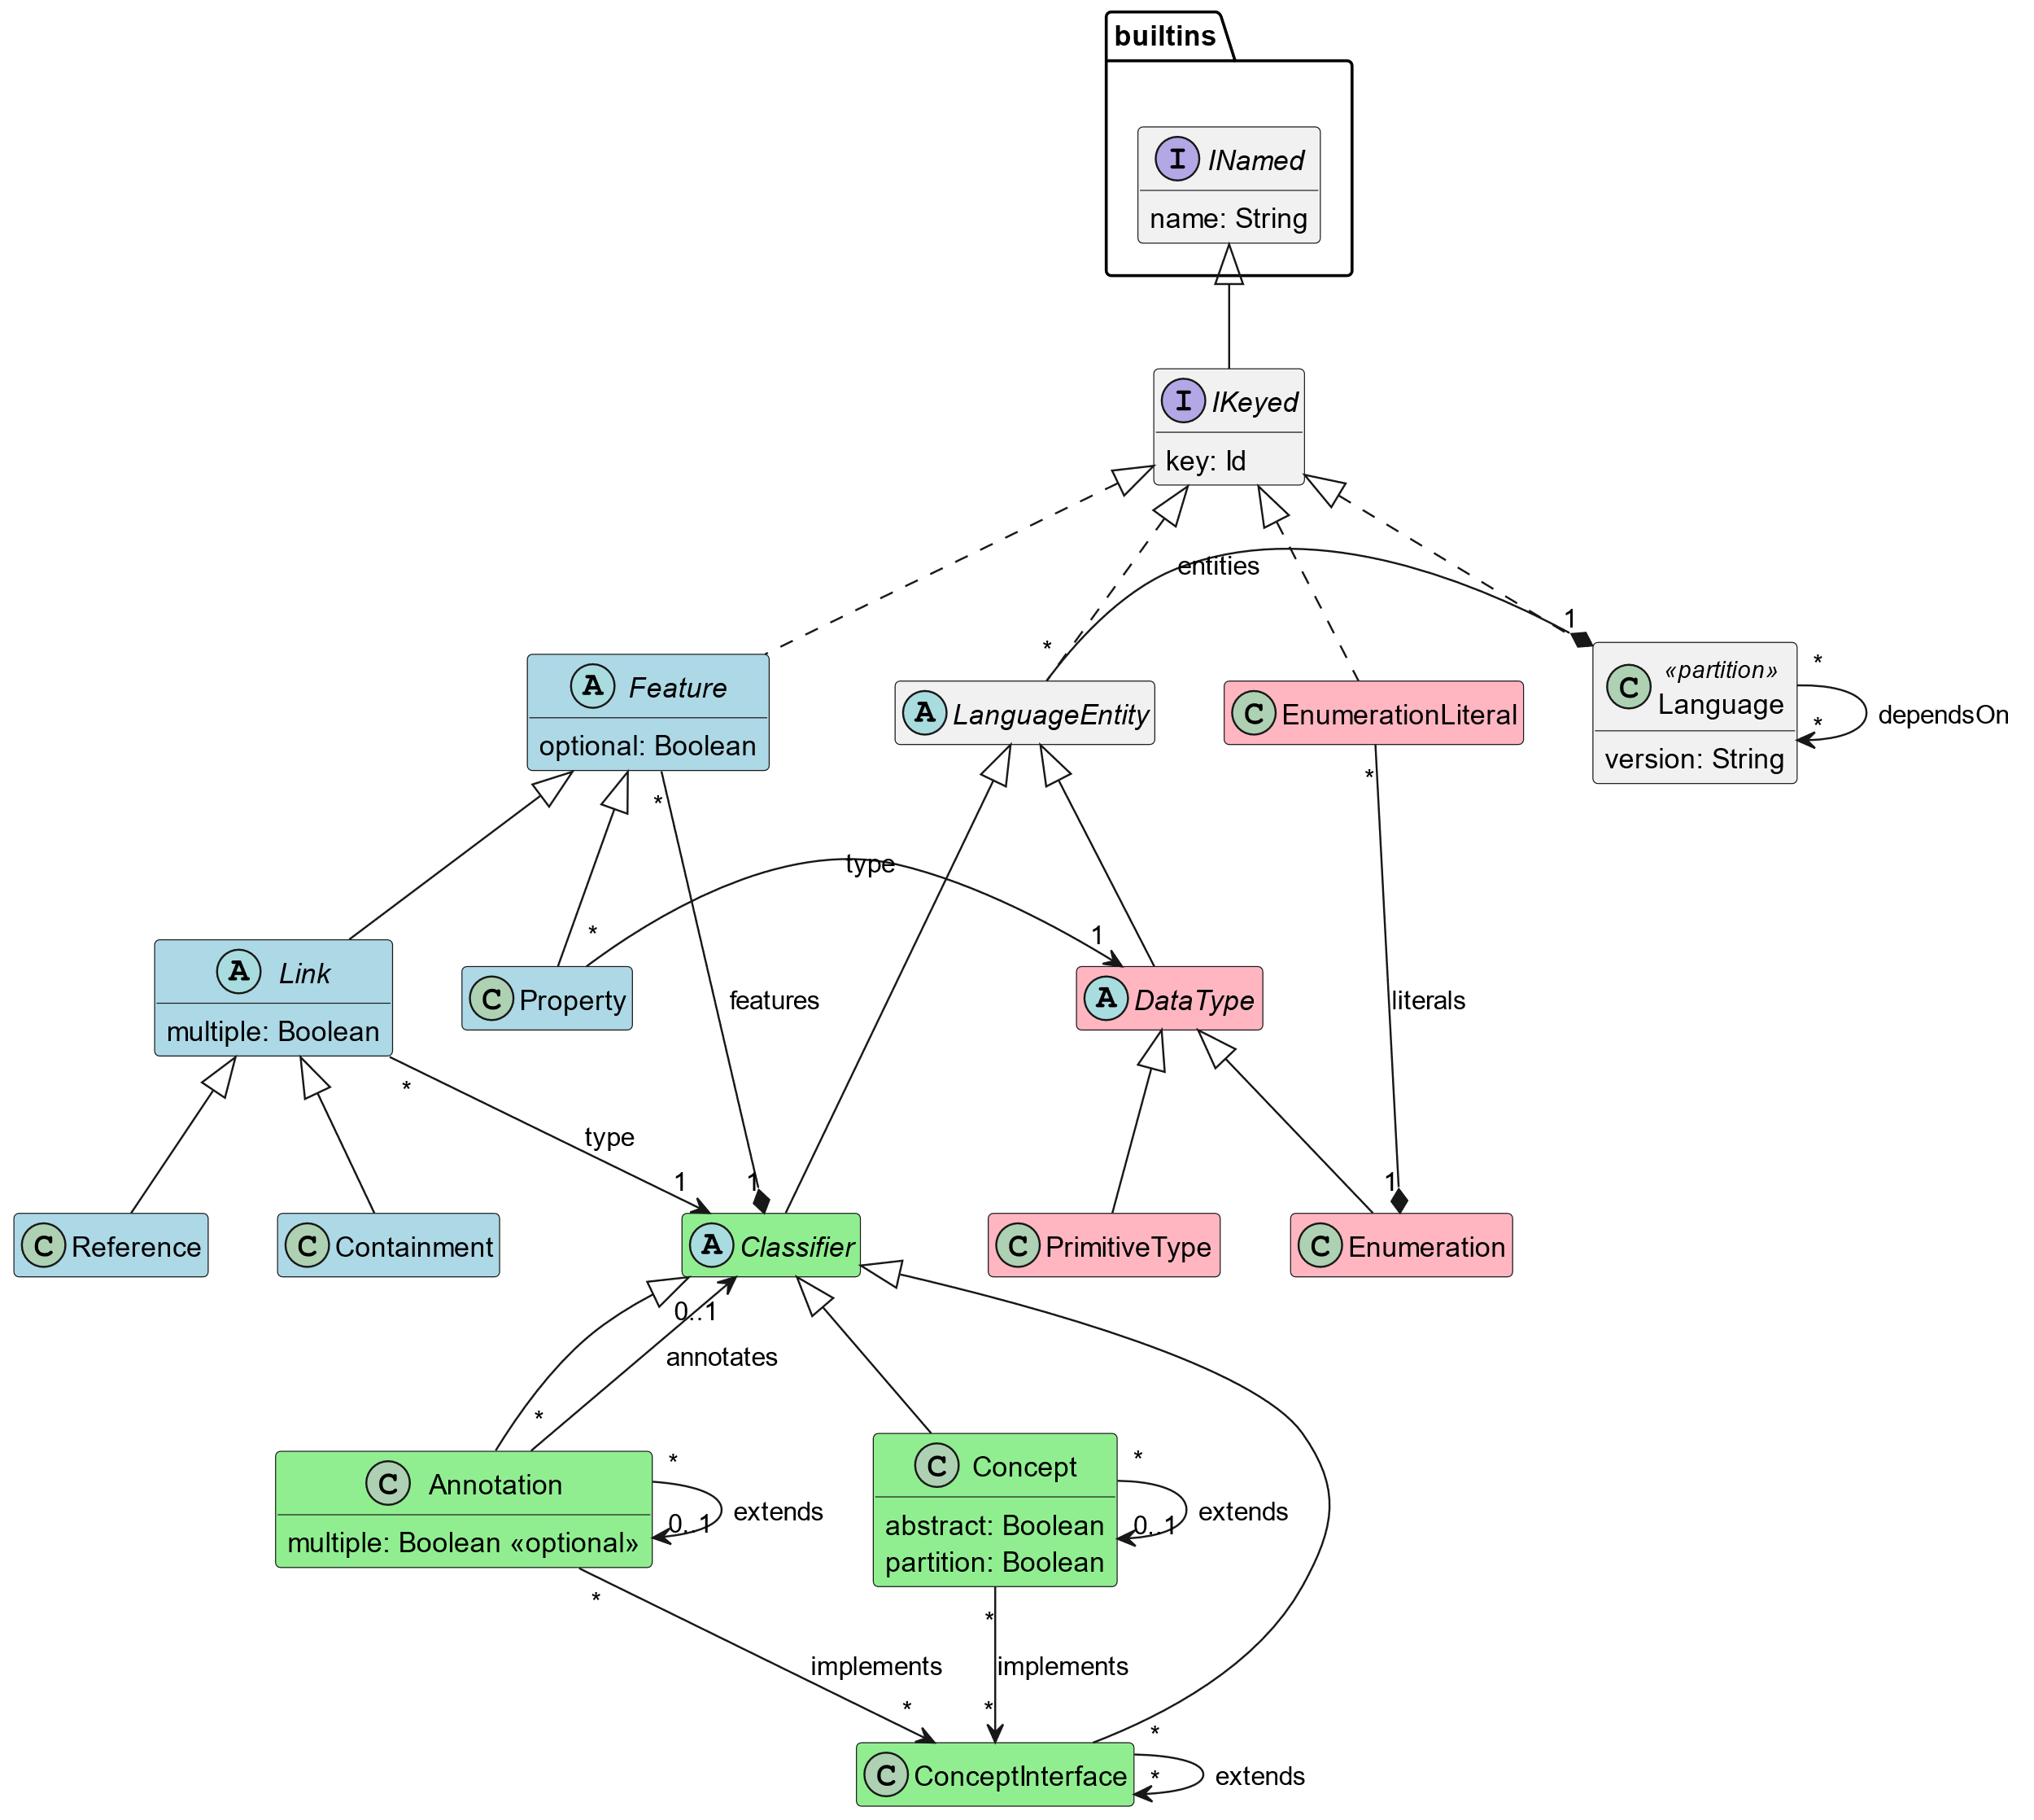
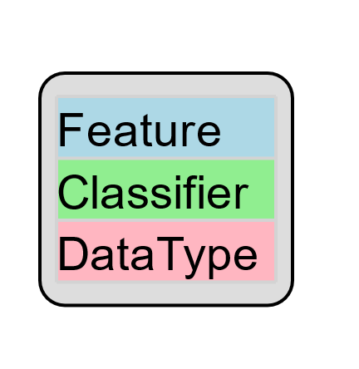
Meta-Metamodel

Slide 8
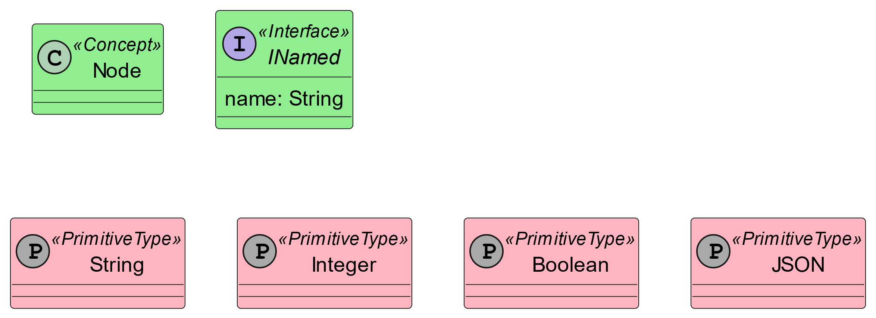
Built-in Standard Library

Slide 9

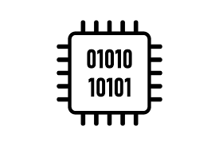
What – Work Products
communication protocol specifications
+ meta-metamodel
reference architecture for cloud-based modeling tools
bindings in several programming languages
reference implementations and examples
Priority

Slide 10











What not – Out of Scope
Yet another Language Workbench
Plug-and-play component system
Deployment scheme

Slide 11
Who – Participation
Meinte Boersma, Freelancer, The Netherlands
Norman Koester, itemis (modelix Team), Germany
Sergej Koscejev, Freelancer, Czech Republic
Sascha Lisson, itemis (modelix Team), Germany
Eugen Schindler, Canon Production Printing, The Netherlands
Alex Shatalin, Jetbrains (MPS Team), Czech Republic
Niko Stotz, F1RE, The Netherlands
Federico Tomassetti, Strumenta, Italy
Markus Voelter, Freelancer, Germany
Jos Warmer, openmodeling (Freon Team), The Netherlands
⇨ And you?

Slide 12
Where – Current Status
First release 2023.1 planned around November 2023
Serialization format, meta-metamodel
APIs
Java, JavaScript, MPS, (C#)
Integrations
EMF, Freon, Kotlin, MPS, *Lasu

